Slide 1
Mitzvah Décor Inspiration
HELEN MILLS Event Space & Theater

Slide 2
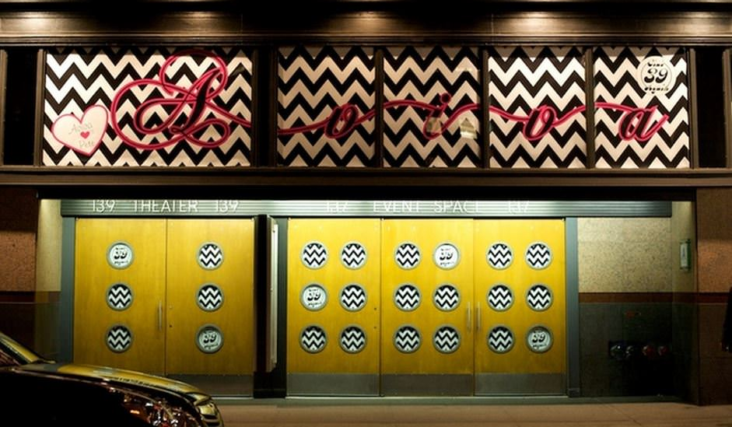
Bold Signage

Slide 3
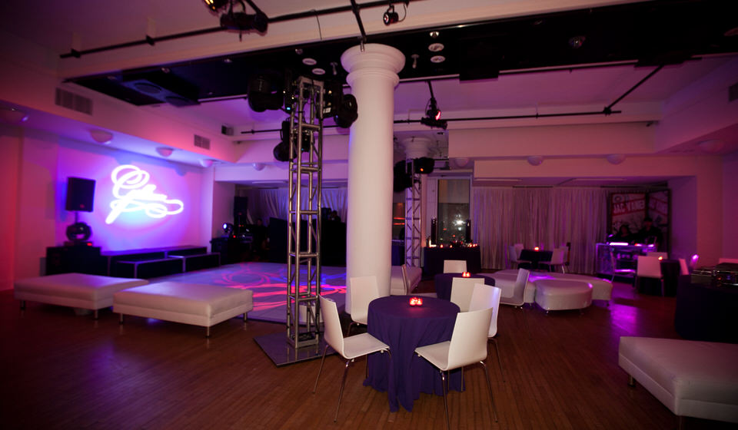
Fun, lively linens

Slide 4
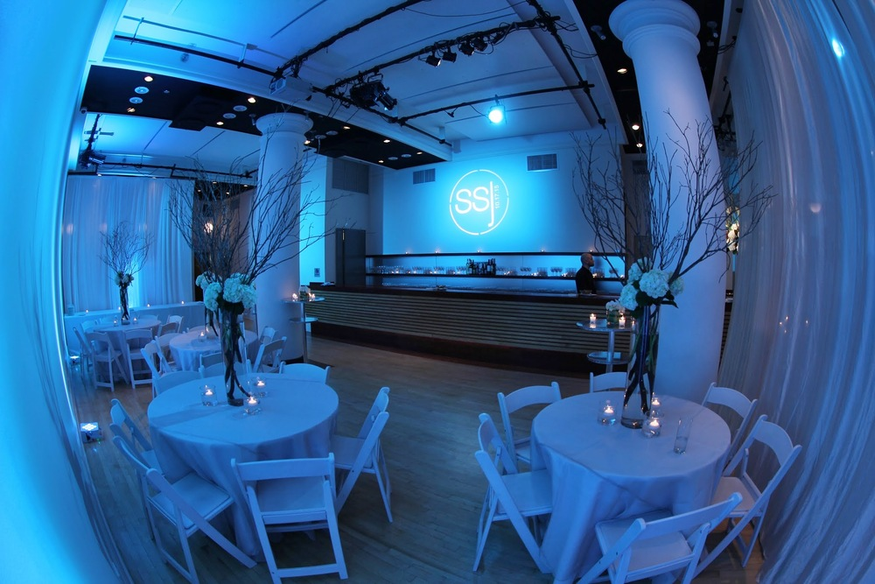
Tall Centerpieces, colored linens & themed gobo
Notes:
Florals by Merriel Weston:
Bar centerpiece - $400
Hightops - $35/each
Centerpieces - $125 (mainly branches with some florals) – includes three candles
Delivery - $100
Pick-up - $100
Labor:
20% admin and tax on all orders
$45/hr + $30/pp trip charge, 2 hour min, 1.5x before 8am, after 5pm.
Two crew members for two hours within normal business horus: $240
Just Artifacts Shipping: starts at $5.00. Varies by order size.

Slide 5
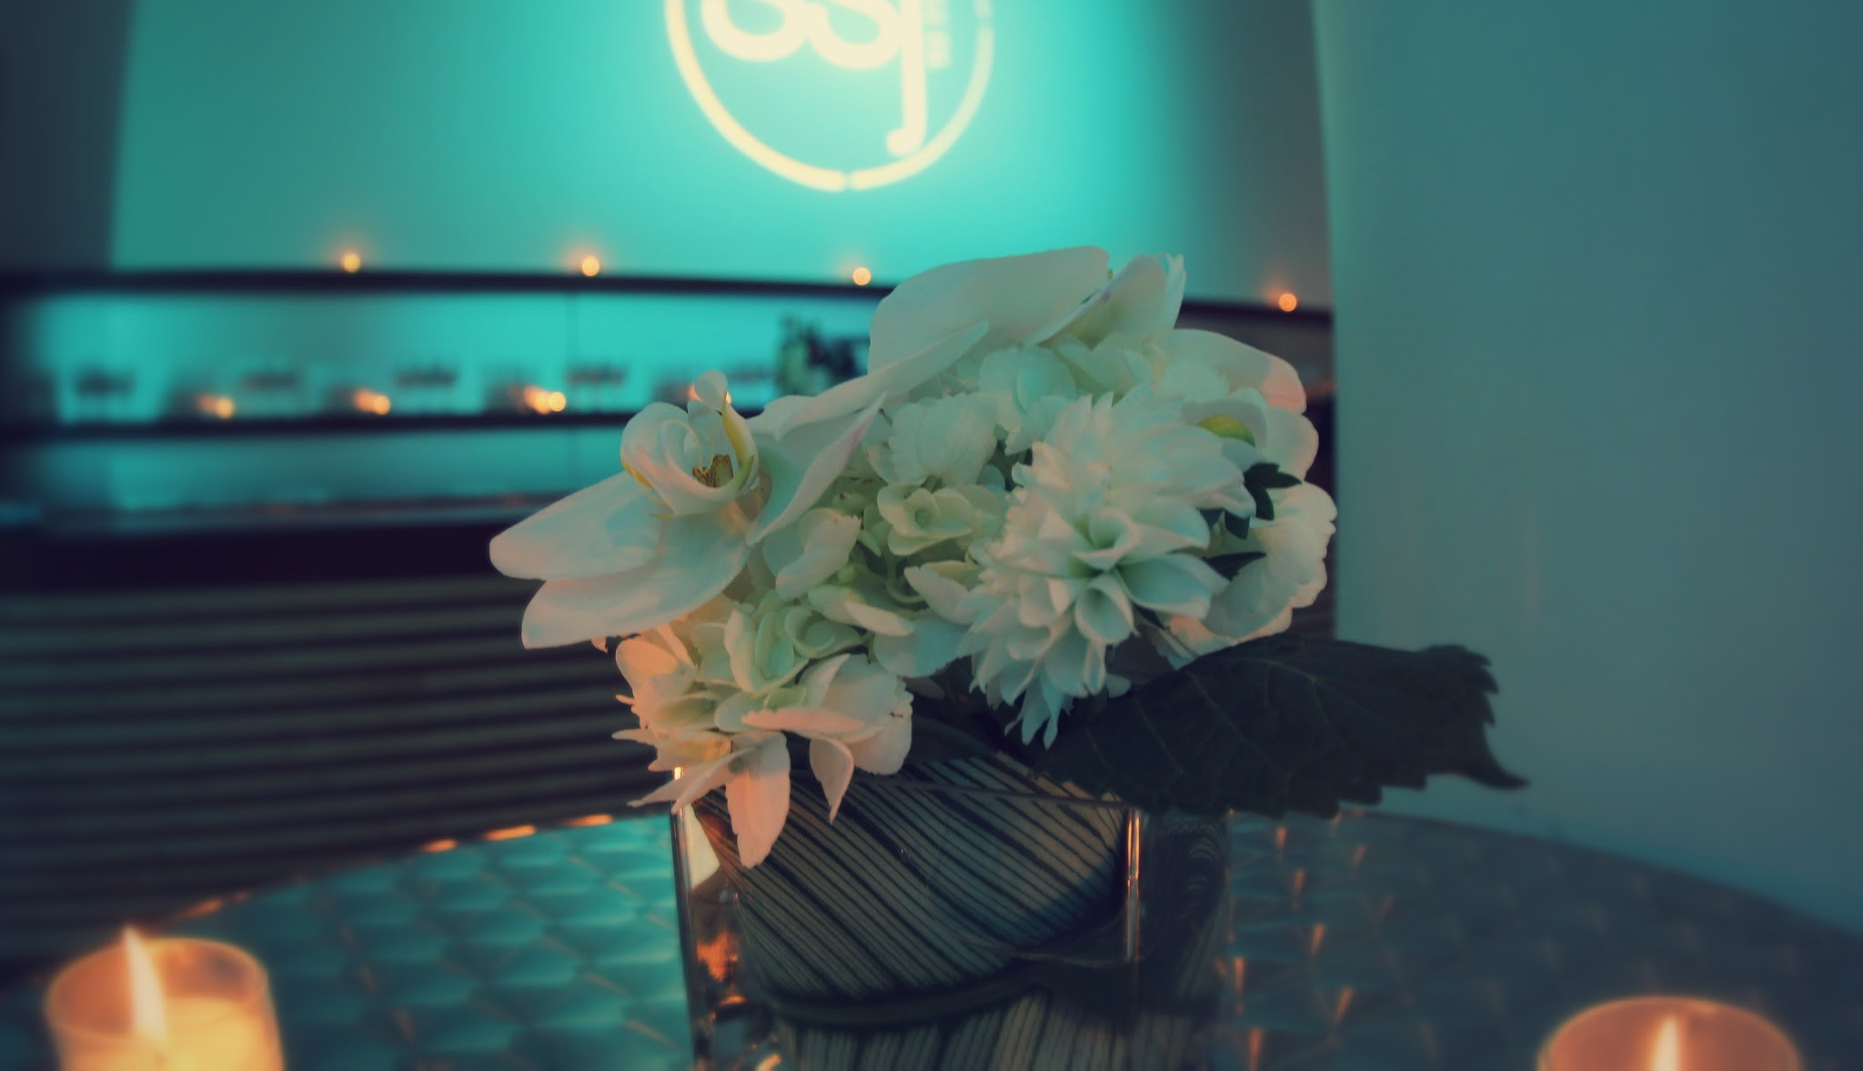
Table centerpieces
Notes:
Florals by Merriel Weston:
Prices for pictured:
Hightops - $35/each
Centerpieces - $125 (mainly branches with some florals) (pictured on prior slide)
Delivery - $100
Pick-up - $100
General Pricing:
Large centerpiece on the bar - $200-400 (depending on type of flowers used and size); Branches will reduce the price – e.g. using dogwood, cherry blossoms and magnolias in the spring / summer (Fall options: pussy willows, orange berries, pines and other berries)
Smaller centerpieces on the bar (2 ends) - $100-200 each (depending on type of flowers and size)
32” cocktail tables - $45-75 each
24” high top tables and end tables - $20-25 each
Delivery fee - $50-100 (depending on how much is being delivered)
20% admin and tax on all orders

Slide 6
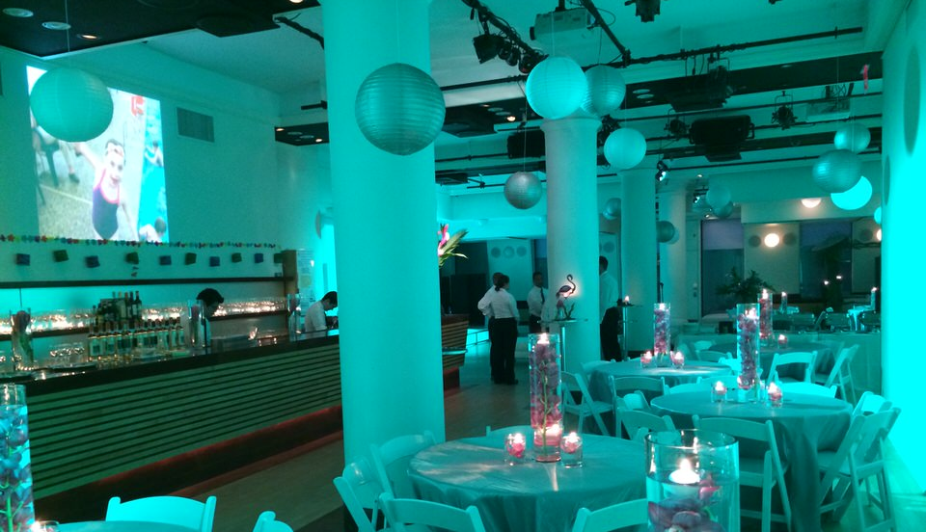
Hanging décor & cool-colored lighting / wall wash

Slide 7
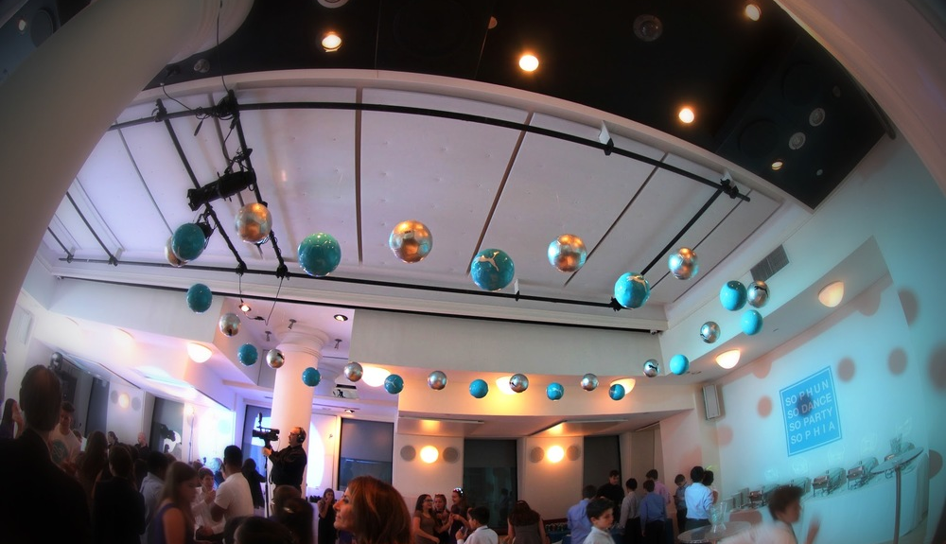
Hanging décor – soccer balls

Slide 8
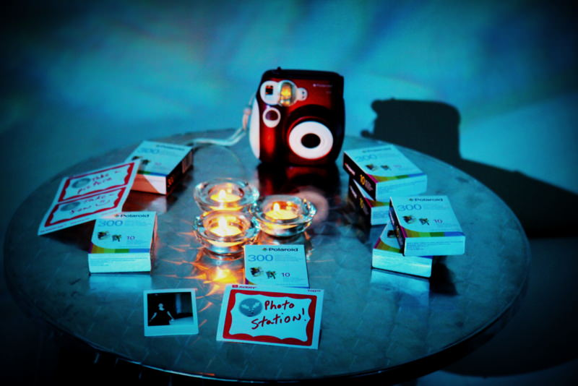
Fun, Interactive Centerpieces

Slide 9
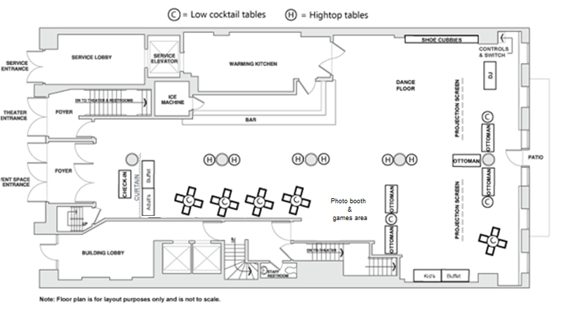
Example Floor Plan #1 Mitzvah with seating area, dinner buffets, photo booth, lounge and dancing areas

Slide 10
Example Floor Plan #2 Mitzvah with seating area, dinner buffets, photo booth, lounge and dancing areas

Slide 11
Sample Décor & Entertainment Pieces
HELEN MILLS Event Space & Theater

Slide 12
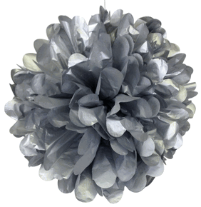
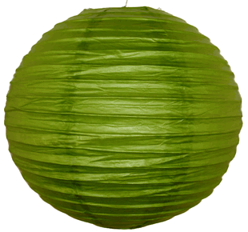
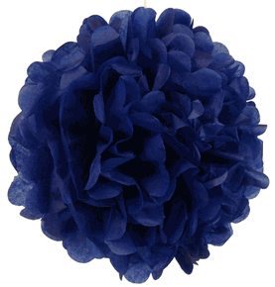
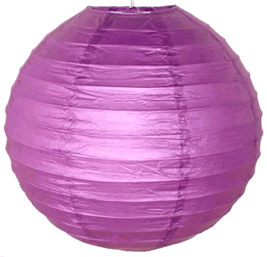
Hanging Decor
Notes:
Ideas
Match colors with party theme, kid’s favorite colors, or traditional mitzvah colors (silver and blue)
Hang different sizes to add variety
Sourcing:
Fishing Wire: $1
Paper pom poms (come in most colors and sizes at 2-inch intervals) - http://www.justartifacts.net/tipompobyco.html
6” - $0.69 (smallest)
14” - $1.73
18” - $2.53
30” - $6.98 (largest – some colors)
Paper lanterns (come in most colors and sizes at 2-inch intervals) - http://www.justartifacts.net/roblpala.html
6” - $0.83 (smallest is 3”)
14” - $1.38
18” - $2.00
24” - $3.18
36” – $128.50/10 pieces or $12.85 each (largest, in white and available in 10pc sets only)
Labor:
20% admin and tax on all orders
$45/hr + $30/pp trip charge, 2 hour min, 1.5x before 8am, after 5pm.
Two crew members for two hours within normal business horus: $240
Just Artifacts Shipping: starts at $5.00. Varies by order size.

Slide 13
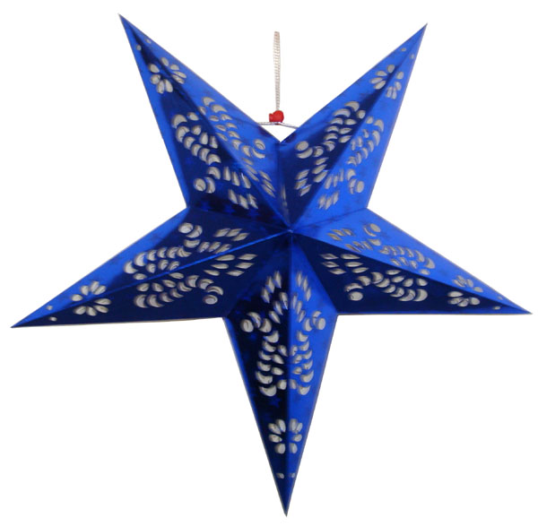
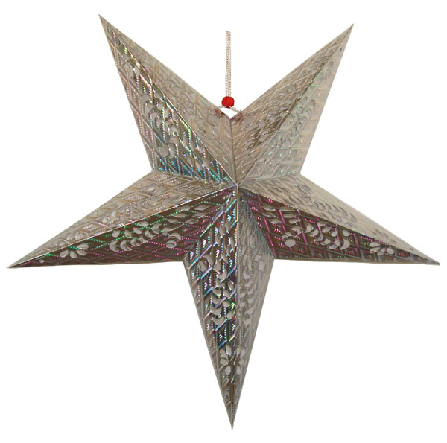
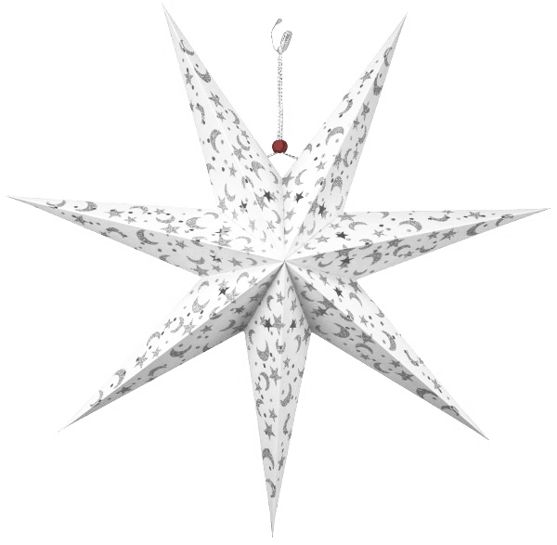
Hanging Decor
Notes:
Ideas
Match colors with party theme, kid’s favorite colors, or traditional mitzvah colors (silver and blue)
Hang different sizes to add variety
Sourcing:
Fishing Wire: $1
Paper Star Lanterns - red, white, gold, blue with patterns - http://www.justartifacts.net/stshpala.html
11” - $2.98 (smallest)
18” - $3.98
24” - $4.48
36” - $6.98 (largest – some colors)
Labor:
20% admin and tax on all orders
$45/hr + $30/pp trip charge, 2 hour min, 1.5x before 8am, after 5pm.
Two crew members for two hours within normal business horus: $240
Just Artifacts Shipping: starts at $5.00. Varies by order size.

Slide 14
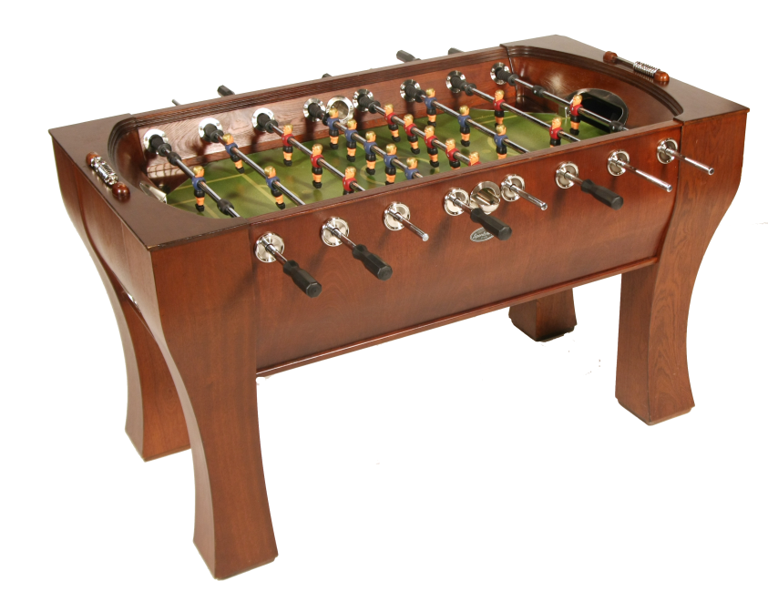
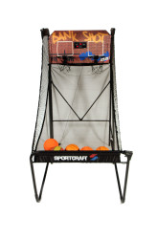
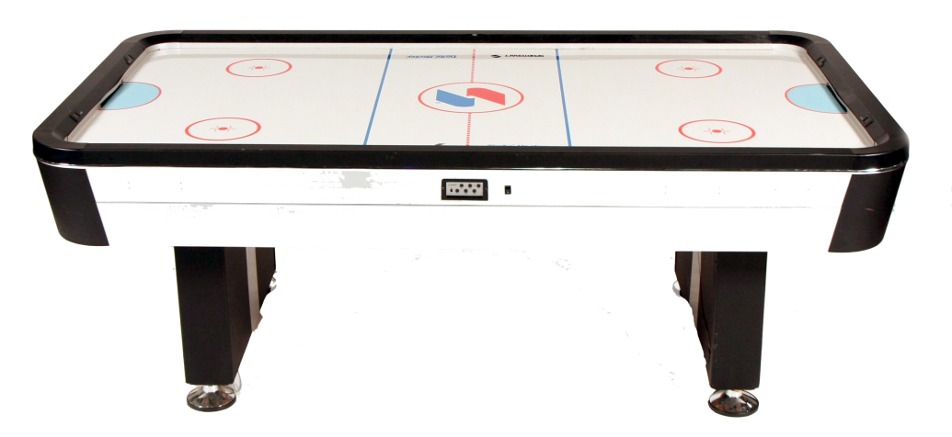
Mini-Arcade Games
Notes:
Pictured from top clockwise: Foosball, pop-a-shot, air hockey table
The Entertainment Company
Mini Arcade Pop-a-Shot (4’x8’), Ping Pong (5’x9’), Pool (4’x8’ – footprint 8’x11’), Foosball (4’x5’), Boccerball – looks like a foosball table except there is a ball that’s moved around by steel marbles that get launched from each player’s side (4’x4’), Air Hockey (4’x8’)
Pricing (includes delivery, setup, breakdown) - up to five hours (will deliver and remove it right after the party)
1 game - $750
2 games - $900
3 game - $1150
Casinos -10 player (mainly 4’x8’ – full size)
Seated and standing – standing blackjack, craps (5’x10’ up to 14 player), roulette, let it ride poker, blackjack
Seated Only – Texas Hold ‘Em (4’x8’)
Anything except for craps (includes delivery, setup, breakdown, and dealers, cards, dice, prizes) - $450 per table for three tables. $1150 for two tables. Craps table is $650. $100 for printing fake money with the CEO on it.

Slide 15
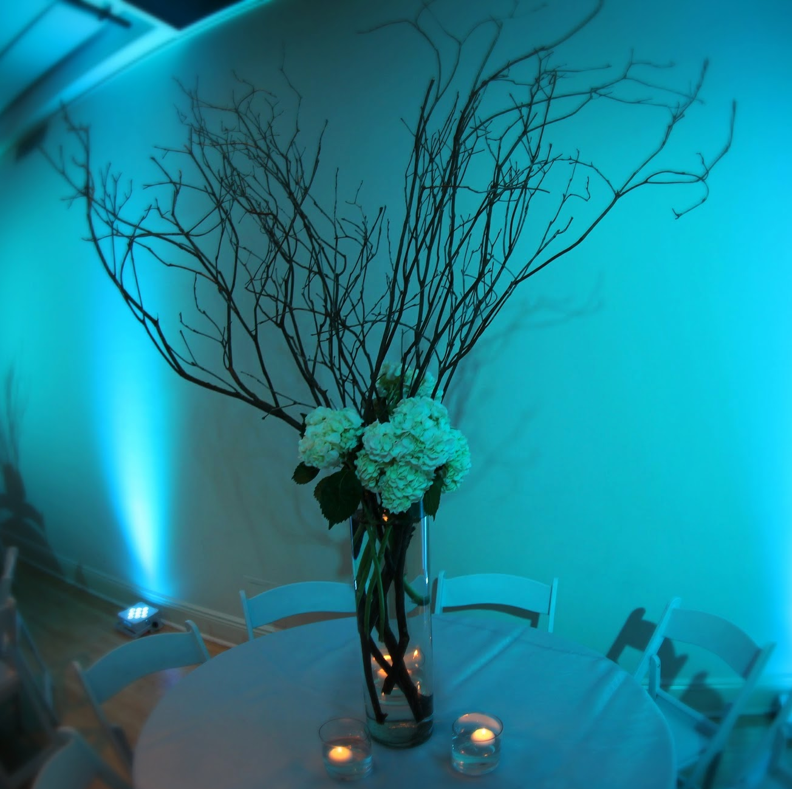
Floral Centerpieces
Notes:
Florals by Merriel Weston:
Prices for pictured:
Centerpieces - $125 (mainly branches with some florals) (large blue circle)
Delivery - $100
Pick-up - $100
General Pricing – may vary based on season and desired vases:
Large centerpiece on the bar - $200-400 (depending on type of flowers used and size); Branches will reduce the price – e.g. using dogwood, cherry blossoms and magnolias in the spring / summer (Fall options: pussy willows, orange berries, pines and other berries)
Smaller centerpieces on the bar (2 ends) - $100-200 each (depending on type of flowers and size)
32” cocktail tables - $45-75 each
24” high top tables and end tables - $20-25 each
Delivery fee - $50-100 (depending on how much is being delivered)
20% admin and tax on all orders

Slide 16
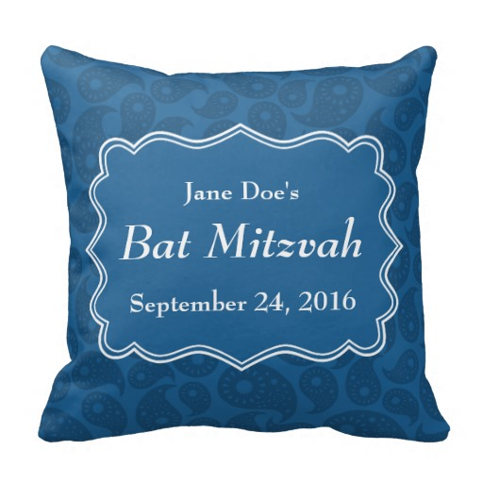
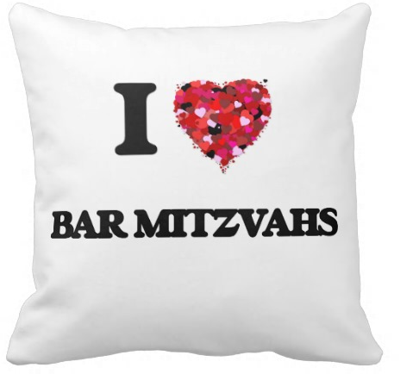
Lounge Décor - Decorative Pillows
Notes:
Customizable pillow from Zazzle.com – 2 week processing and shipping time - http://www.zazzle.com/custom/square+pillows
16” x 16” - $29.95 per customizable polyester pillow (recommended)
20” x 20” - $44.95
I <3 Bar Mitzvahs - $35.55 or $53.35 for 20” x 20”
Two pillows per ottoman – 16” x 16” pillows for all ottomans: $300
Shipping - $6.95, likely varies by quantity

Slide 17
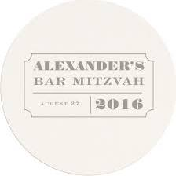
Custom Napkins & Coasters
Notes:
Napkins – PaperSource - http://www.papersource.com/item/Ticket-Mitzvah-Custom-Cocktail-Napkins/2710_030_002/201310669219408.html
Set of 50 for $38.50 + shipping and tax
Coasters – PaperSource - http://www.papersource.com/item/Ticket-Mitzvah-Custom-Coasters/2710_032_002/2013357222408.html
Set of 50 for $29 + shipping and tax

Slide 18
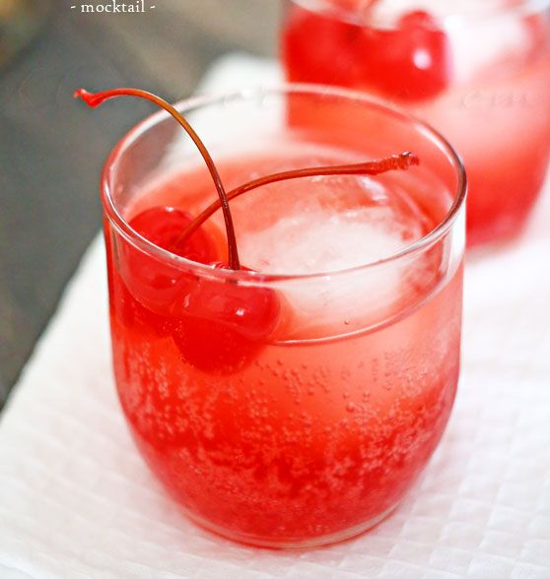
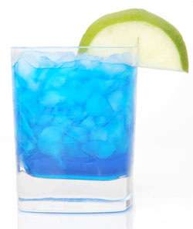
Mocktails
Notes:
$5/pp for up to 2 mocktails
Left to Right: Cherry Bomb Mocktail, Blue Ocean Cocktail
Cherry Bomb Mocktail
Ingredients 1 liter lemon lime soda 4 ounces grenadine juice from 1 lime (approx 2 tbsp) 4 maraschino cherries get ingredients
Instructions 1. Combine soda, grenadine & lime juice in mixing glass & stir 2. Pour over rocks or ice ball in low ball glass 3. garnish with cherries
Blue Ocean Mocktail
Ingredients: Curacao Bleu Syrup - 1 to 2 tblspn, Icecubes as needed, Simple Syrup, Club Soda Water - as needed, Lime Wedge
Instructions: Take a serving glass, fill it half way with ice. Add in curacao syrup, simple syrup, soda water, and lime wedge. Mix this whole thing up.

Slide 19
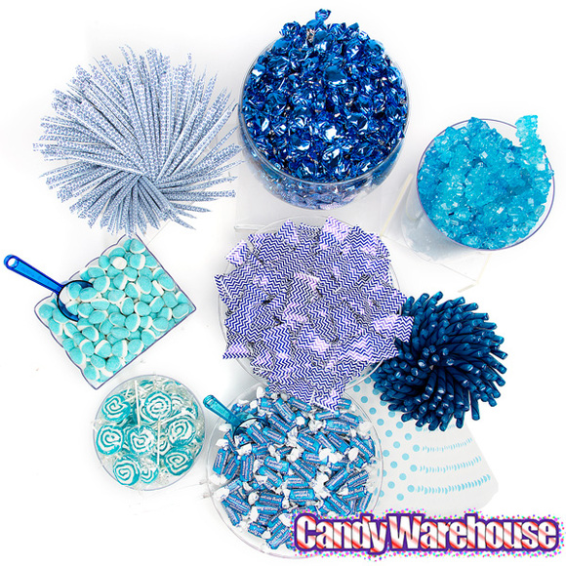
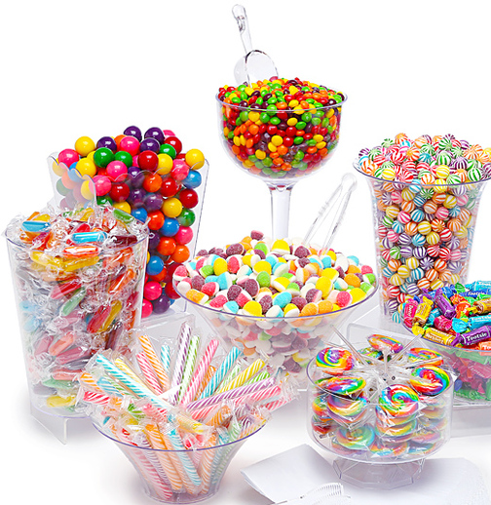
Candy Bars
Notes:
Candy Buffet Kit - http://candy.candywarehouse.com/search?p=KK&srid=S12-USWSEAI02&lbc=candywarehouse&ts=custom&pw=candy%20buffet%20kit&uid=750703963&isort=score&view=grid&w=Buffet%20Kit&rk=3
Serves 25-50, cost is $250 - $300 depending on color (silver, blue, pink, yellow, orange, green, multi-colored)
Shipping: $70 for one
Buffet Kit Includes- Containers and Supplies: (2) Aqua Blue Polka Dot Candy Bags: 25-Piece Pack (1) Navy Blue Plastic 4-Ounce Candy Scoop (1) Caribbean Blue Plastic 4-Ounce Candy Scoop (1) Super Clear Acrylic 6-Inch Candy Tongs (2) Clear Bowl Flared Candy Container - Large (1) Clear Bowl Flared Candy Container - Small (1) Clear Plastic Trifle Candy Container - Large (1) Clear Popcorn Style Candy Container - Large (1) Clear Trifle Candy Container - Small (1) Clear Cylindrical Candy Container - Large (1) Clear Plastic Jumbo Candy Container Candy: (2) 80-Piece Boxes of Blueberry Old Fashioned Hard Candy Sticks (2) 1-Pound Bags of Vanilla Tootsie Rolls Candy (1) 100-Piece Bag of Hypno Pops Petite Blue & White Swirled Lollipops (1) 5-Pound Box of Blue Rock Candy Strings (1) 300-Piece Box of Royal Blue Chevron Stripe Wrapped Buttermint Creams (1) 5-Pound Bag of Metallic Blue Foiled Hard Candy Buttons (2) 50-Piece Bags of Blueberry Sassy Straws Candy Powder Filled Mini Straws (1) 5-Pound Bag of Blue Raspberry Petite Pufflettes Gummy Bites

Slide 20
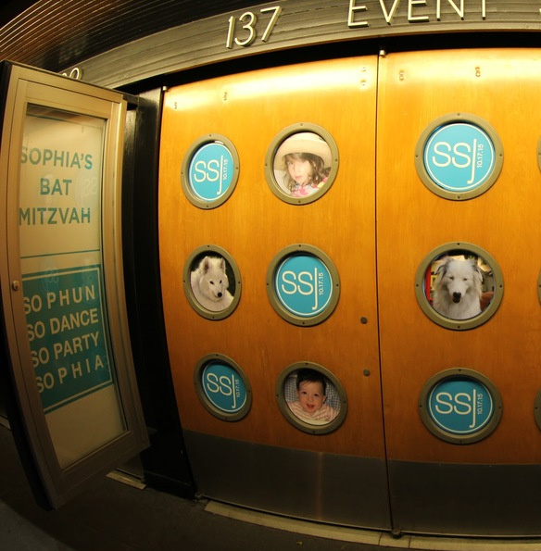
Exterior & Interior Signage
Notes:
Atlas Print Solutions - Gregg Morgan - gregg@atlasprintsolutions.com - 212-949-8775
Estimated costs for signage:
Window Portholes - $10.33 each or $247.90 for all 24 portholes (static cling - $12.83 each (can be removed and sometimes re-used))
Two sided sidewalk showcase - $82/side or $164 for both sides
Large upper windows - $755

